Slide 1

Apple Stock Price Forecasting
Gunabhiram billa (11484513)
Bhanu Shruthi Nayudu (11480187)

Slide 2
TABLES OF CONTENT
Abstract & Objective
Data Description and Preparation
Data Exploration
Forecasting models
Conclusion

Slide 3
Abstract & Objective
Target Variable – Price
Objective – To understand Predictive Analytics and Business forecasting concepts in stocks
Stock market process is full of uncertainty; hence stock prices forecasting very important in finance and business. For stockbrokers, understanding trends and supported by prediction software for forecasting is very important for decision making.

Slide 4
Data Description and Preparation
The Dataset is taken from Kaggle - https://www.kaggle.com/subbhashit/stock-price-predictions
In this data set, we have 4 attributes DATE, STATE, COMMODITY AND PRICE, but we use only price and date attributes. Price is dependent variable and date is independent variable for our forecasting.
The original dataset has 5663 observations.
After Data cleaning we have 262 observations by removing duplicates. We will be focusing on day seasonal cycle, price value for projecting time series.

Slide 5
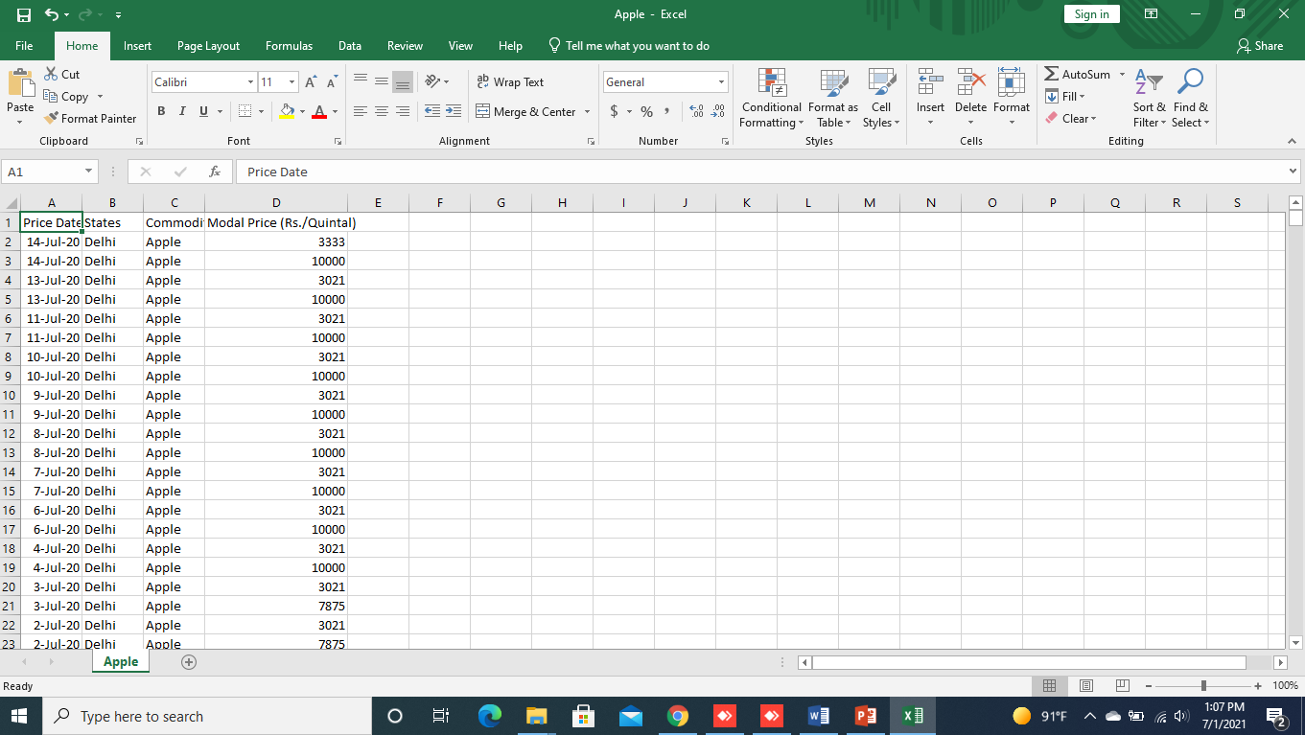
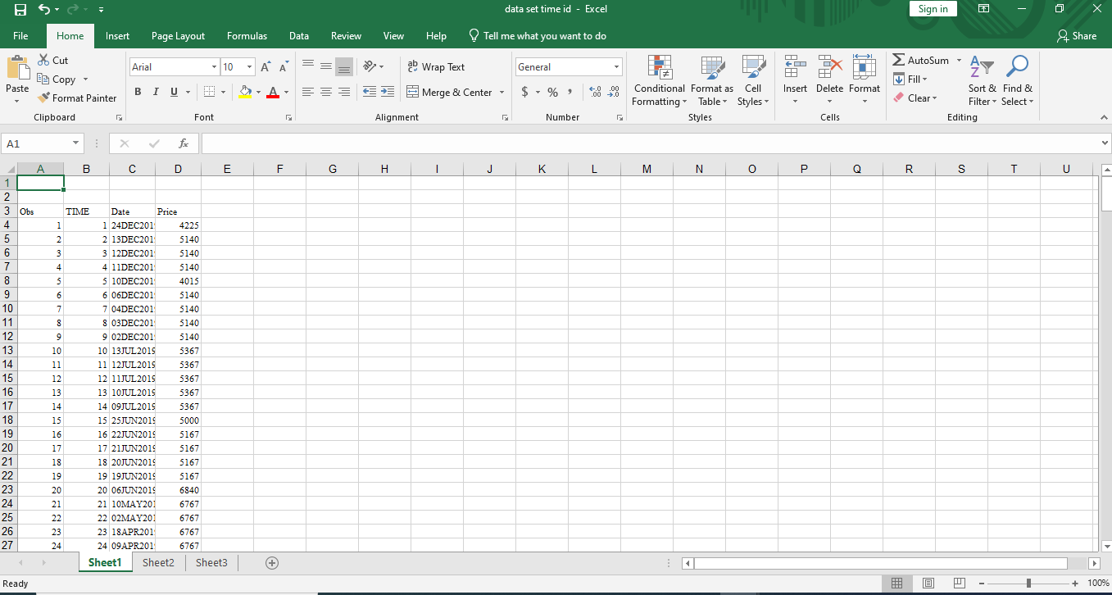
Initial Dataset Final Dataset

Slide 6
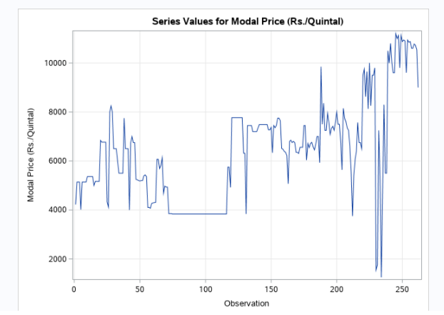
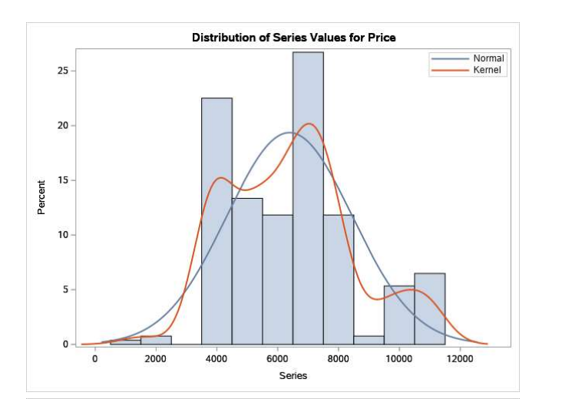
Data Exploration
Data exploration is the initial step in data analysis, where users explore a large data set in an unstructured way to uncover initial patterns, characteristics, and points of interest. ...

Slide 7
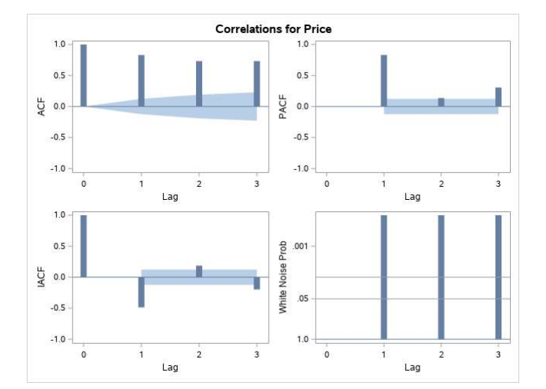
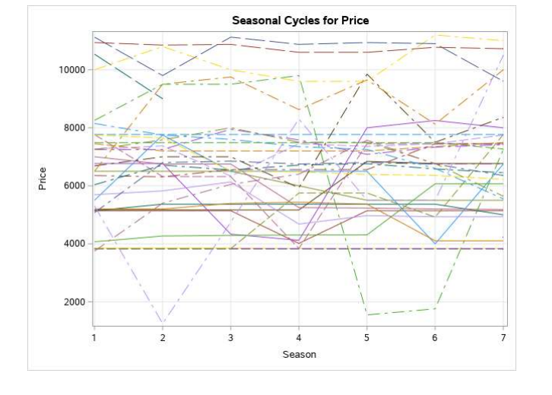

Slide 8
Forecasting models
In the first step we find Trends and seasonal cycles in the data set. The main point is the data should be stationary with mean and variance, for the data set we provided the data set is non seasonal which means it is stationary.
Hypothesis
Null Hypothesis Ho : ARIMA model is best suitable for the dataset.
Alternative Hypothesis Ha: ARIMA model is not the best suitable for the data set.

Slide 9
Random Walk
A random walk is different from a list of random numbers because the next value in the sequence is a modification of the previous value in the sequence. The process used to generate the series forces dependence from one-time step to the next. This dependence provides some consistency from step-to-step rather than the large jumps that a series of independent, random numbers provides.
It is this dependency that gives the process its name as a “random walk” or a “drunkard’s walk”.
A simple model of a random walk is as follows:
Start with a random number of either -1 or 1.
Randomly select a -1 or 1 and add it to the observation from the previous time step.
Repeat step 2 for as long as you like.
y(t) = B0 + B1*X(t-1) + e(t)
Where y(t) is the next value in the series. B0 is a coefficient that if set to a value other than zero adds a constant drift to the random walk. B1 is a coefficient to weight the previous time step and is set to 1.0. X(t-1) is the observation at the previous time step. e(t) is the white noise or random fluctuation at that time.

Slide 10
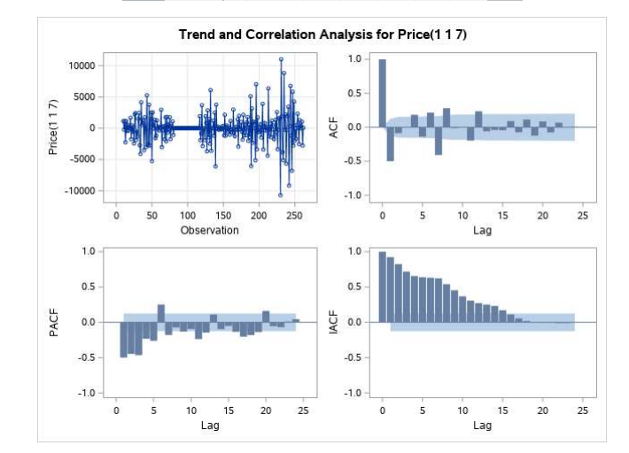
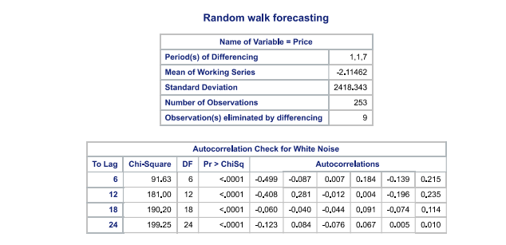

Slide 11
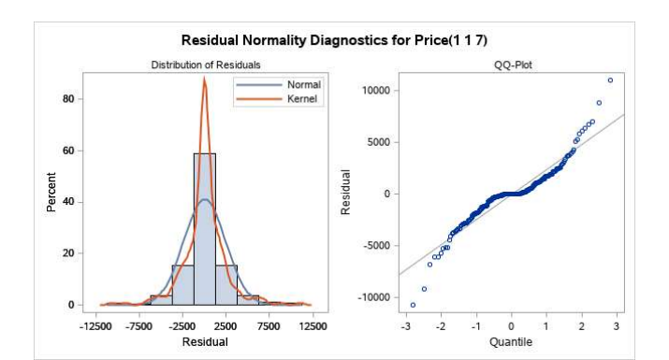
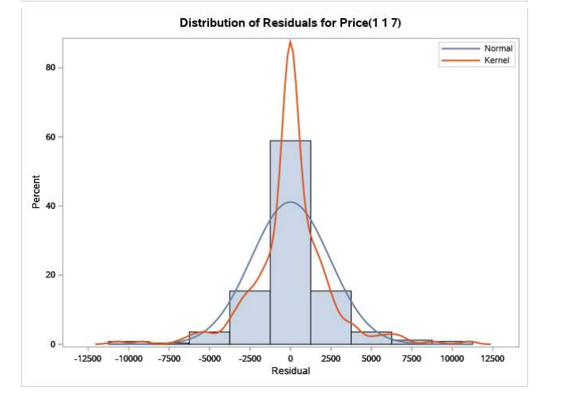
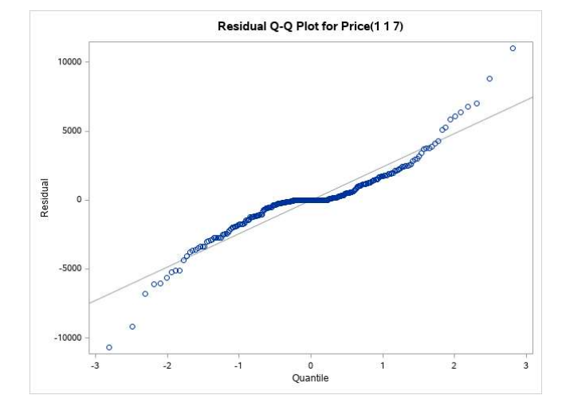

Slide 12
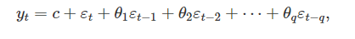
Moving Average
Rather than using past values of the forecast variable in a regression, a moving average model uses past forecast errors in a regression-like model.
where εt is white noise. We refer to this as an MA(q) model, a moving average model of order qq. Of course, we do not observe the values of εt, so it is not really a regression in the usual sense.
Notice that each value of yt can be thought of as a weighted moving average of the past few forecast errors. However, moving average models should not be confused with the moving average smoothing. A moving average model is used for forecasting future values, while moving average smoothing is used for estimating the trend-cycle of past values.

Slide 13
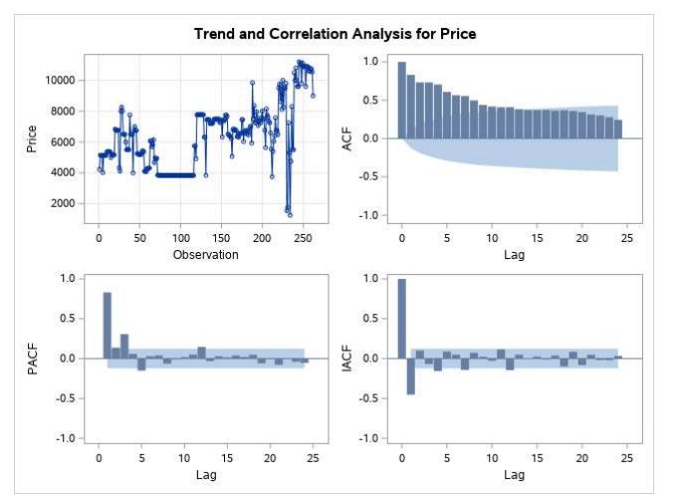

Slide 14
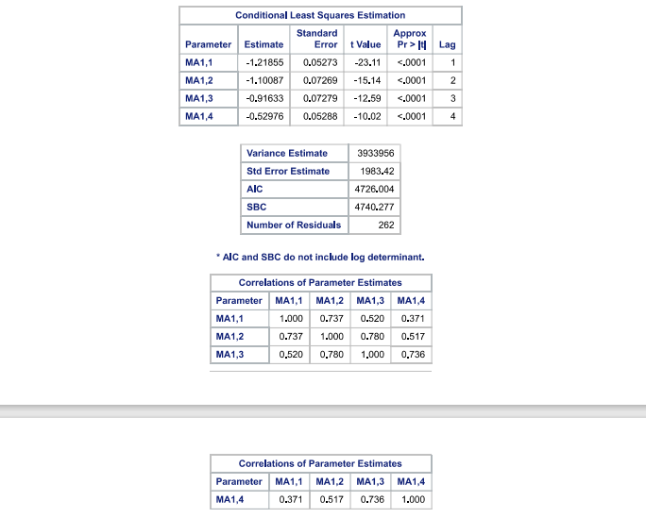
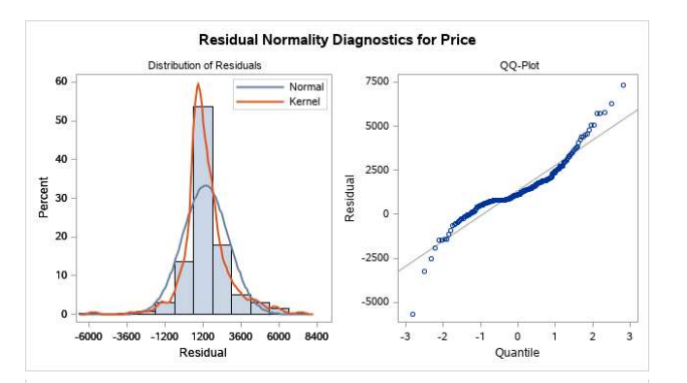

Slide 15
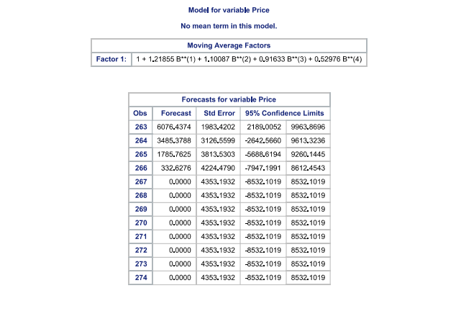
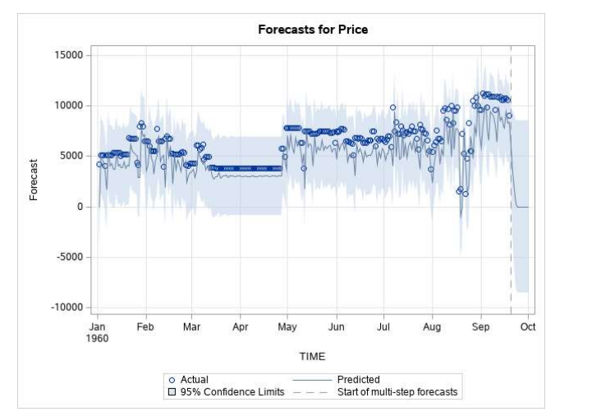

Slide 16
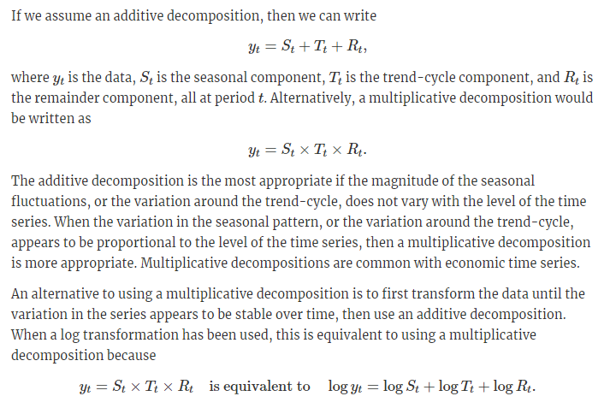
Decomposition
Time series decomposition involves thinking of a series as a combination of level, trend, seasonality, and noise components.
Decomposition provides a useful abstract model for thinking about time series generally and for better understanding problems during time series analysis and forecasting.

Slide 17
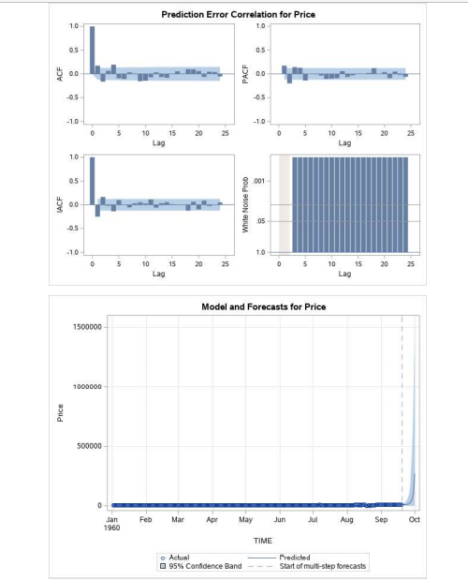

Slide 18
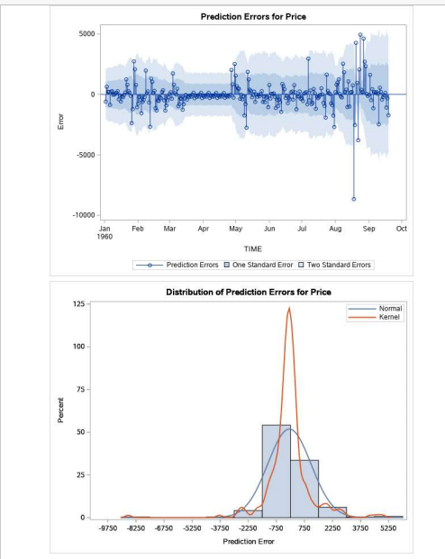
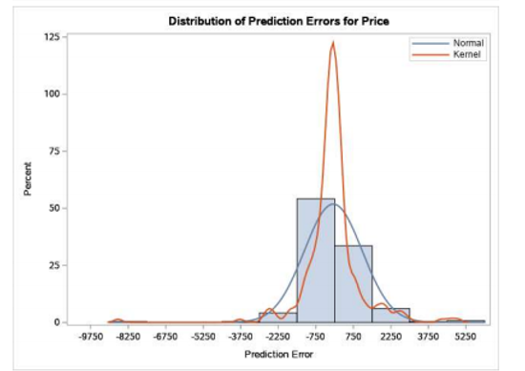

Slide 19
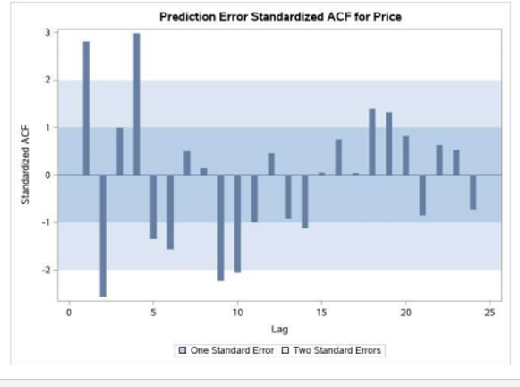
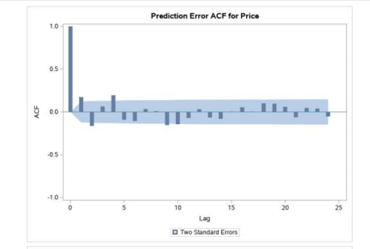
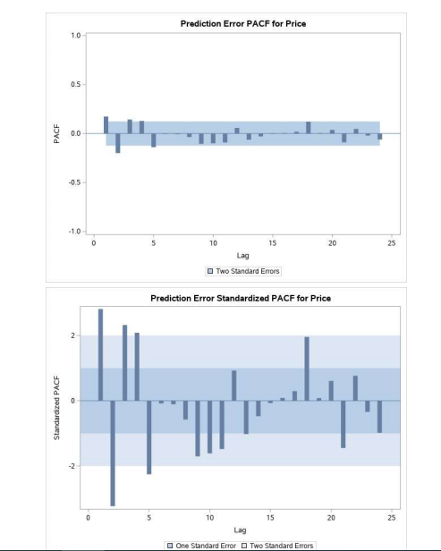

Slide 20
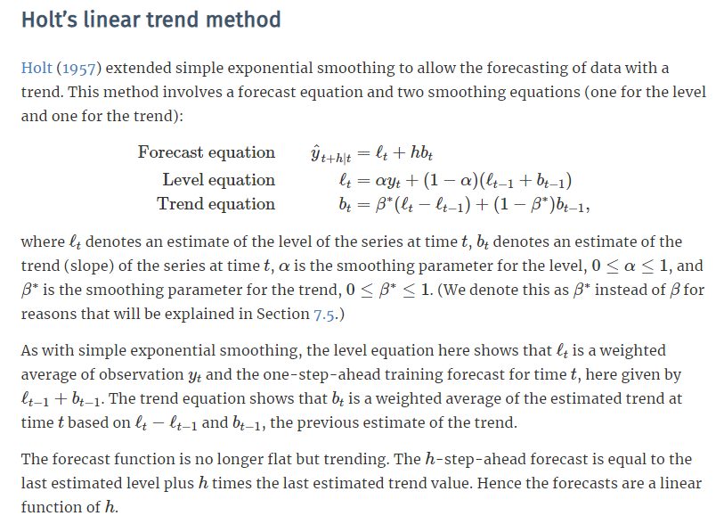
Holts Exponential Smoothing

Slide 21
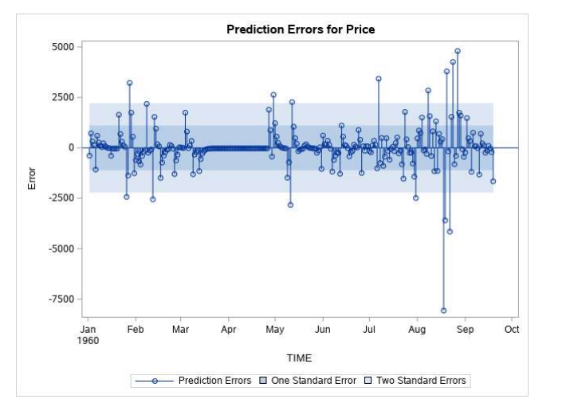
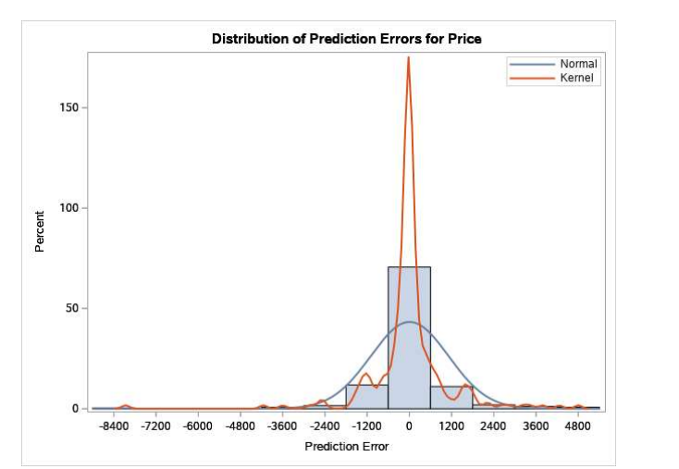

Slide 22
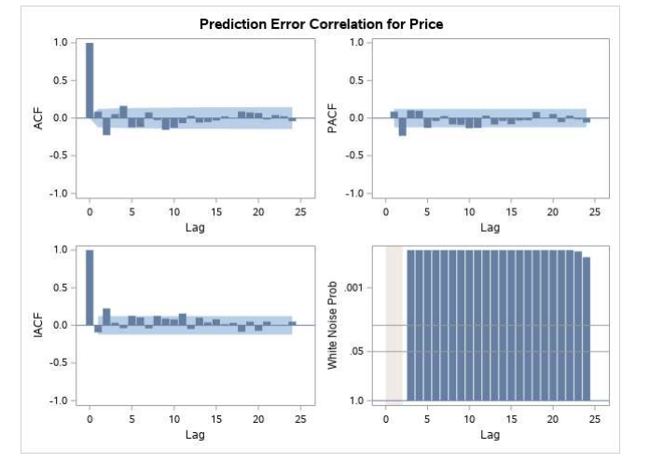
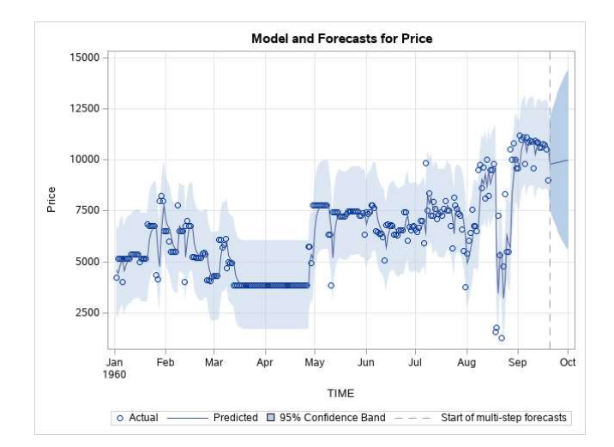

Slide 23
ARIMA
A stationary time series is one whose properties do not depend on the time at which the series is observed. Thus, time series with trends, or with seasonality, are not stationary — the trend and seasonality will affect the value of the time series at different times. On the other hand, a white noise series is stationary — it does not matter when you observe it, it should look much the same at any point in time.
Some cases can be confusing — a time series with cyclic behaviour (but with no trend or seasonality) is stationary. This is because the cycles are not of a fixed length, so before we observe the series we cannot be sure where the peaks and troughs of the cycles will be.
In general, a stationary time series will have no predictable patterns in the long-term. Time plots will show the series to be roughly horizontal (although some cyclic behaviour is possible), with constant variance.

Slide 24
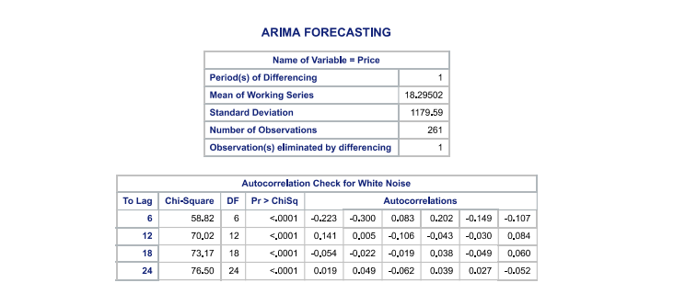

Slide 25
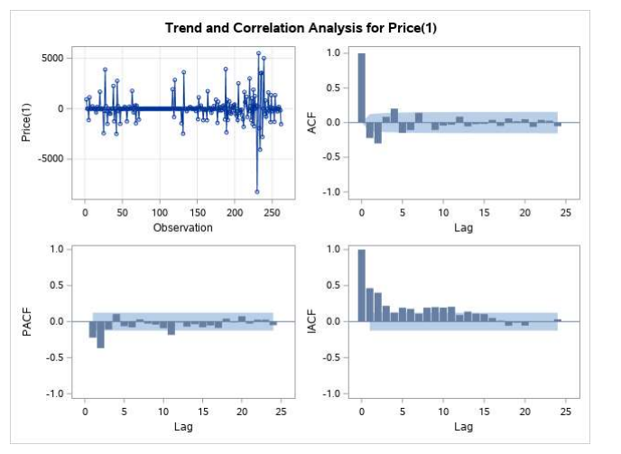
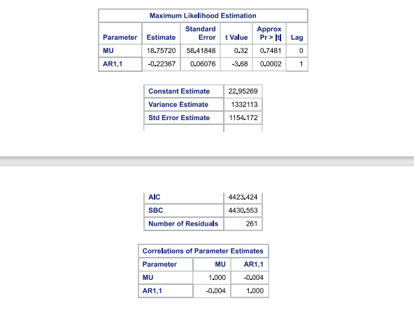

Slide 26
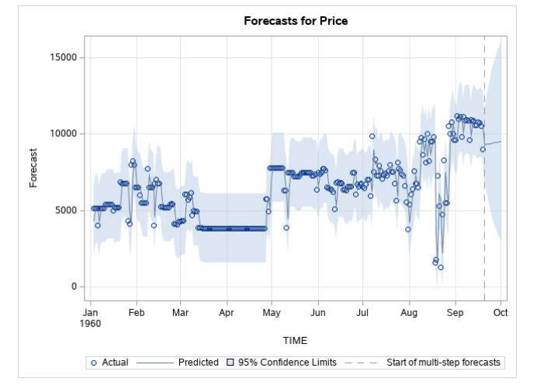
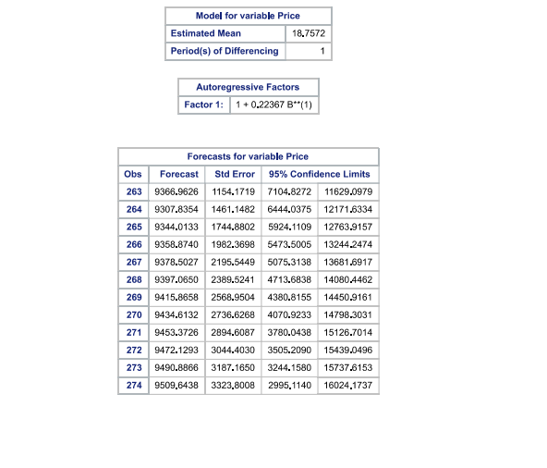

Slide 27
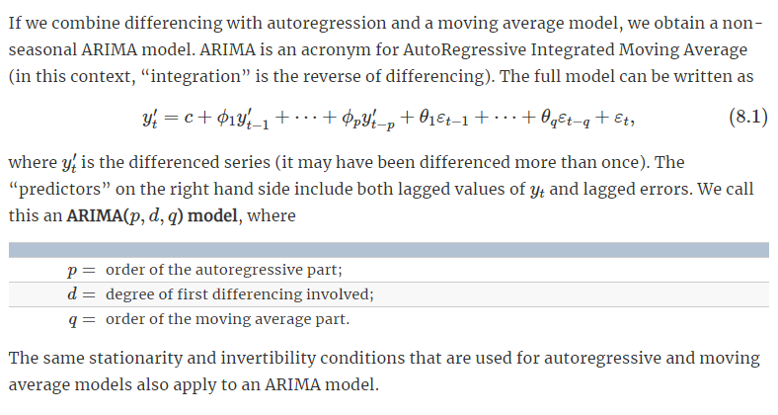
NON-SEASONAL BOX JENKINS
Checking for Stationarity
For ARIMA, time series has to be made stationary for further analysis. For a time series to be stationary, its statistical properties(mean, variance, etc) will be the same throughout the series, irrespective of the time at which you observe them. A stationary time series will have no long-term predictable patterns such as trends or seasonality. Time plots will show the series to roughly have a horizontal trend with the constant variance.

Slide 28
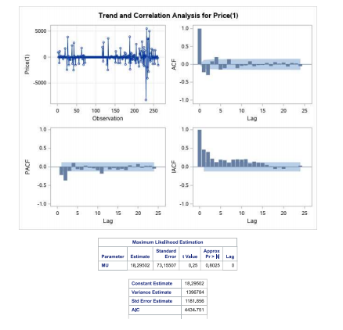

Slide 29
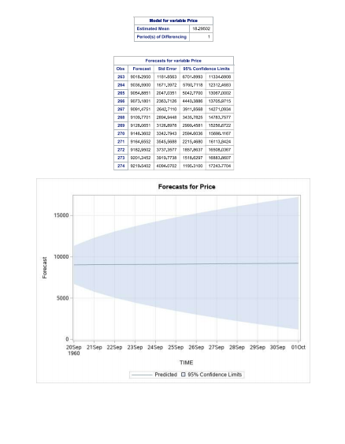
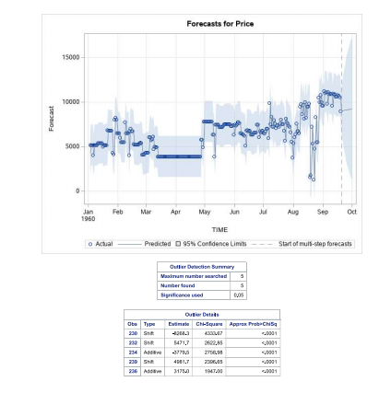

Slide 30

Conclusion
On the basis of t value and p value of maximum likelihood estimation, standard error, AIC and SBC we can say ARIMA model is best suitable for forecasting and we don’t reject the null hypothesis.

